Slide 1
Tesco Grocery 1.0 Dataset vs. Household Income

Slide 2
Task 1 - Description of the Dataset
Records purchases by Tesco Clubcard users at each of the different Tesco stores in Greater London in 2015.
Broken down by month (and collated into a yearly measure) and different regional measures (by borough, ward, MSOA and LSOA).
Dataset contains fields related to: location, nutritional statistics, energy (caloric) breakdown, food category breakdowns: proportion of items purchased of a certain product category (by count and by weight), demographics and data quality.
Value of data:
Healthcare: Data can be used to study how diet affects health outcomes and how deprivation/income affects diet etc.
Allows analysis at smaller scale level of LSOA all the way to the borough level --> can see more general and small scale patterns.
Monthly data allows temporal analysis of diet, spending etc.
What does it contin
Notes:
Nutritional stats of the average product consumed in an area.
Nutritional: nutrients like sugar, salt etc.
Demographic: population, male, female, and age brackets (age_0_17, age_65+)
Data quality: representativeness_norm

Slide 3
Task 1 - Limitations of the Dataset
Limitation 1
Limitation 2
Tesco Clubcard users
Dataset only consists of purchases made by Tesco Clubcard users. Might not be representative of all Tesco customers or all supermarket customers in general.
Self-selection bias: Tesco Clubcard is an opt-in free loyalty program. Might be more likely to be used by price sensitive consumers, older people families etc. and not by perhaps wealthy people, younger people etc.
Concentration of Tesco stores
Concentration of Tesco stores is higher in North London: less representative of spending habits for some regions like Kingston upon Thames (representativeness norm = 0).
Notes:
Does not account for food-related spending such as at restaurants. Also excludes online purchases

Slide 4
Task 1 - Limitations of the Dataset
Limitation 3
Limitation 4
Trends amongst individuals
Analysis of individuals is not possible, only by region: data is provided at a regional level.
Broad Product Categories
Over 67,000 distinct products are condensed into just 17 product categories.
Categories might be too vague: is a readymade item a healthy salad or a pizza? Data could hide certain trends e.g. veganism, rise in unhealthy processed foods etc.

Slide 5
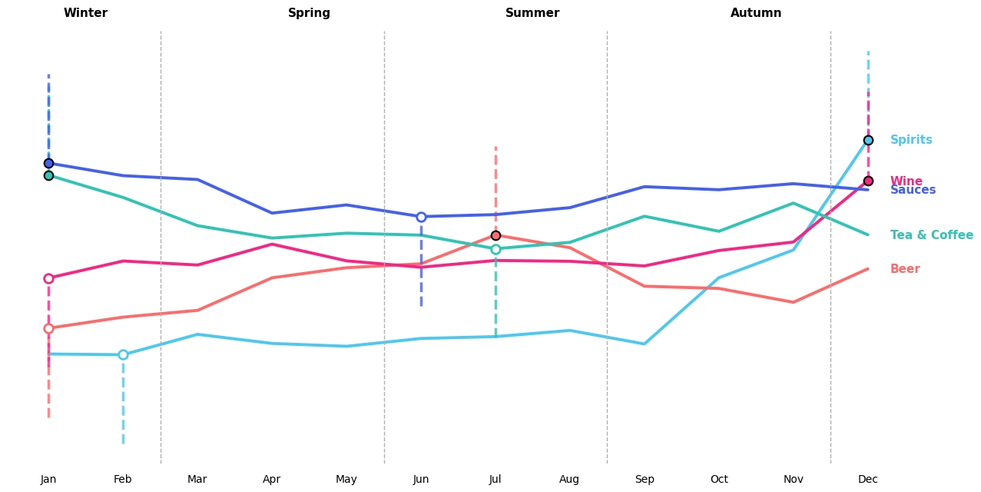
Insight 1- Seasonality Trends on Wards Level
Seasonal Level Insights
Winter (Dec–Feb): Peak demand driven by Spirits and Wine --> strong gifting & festive occasions
Spring (Mar–May): Stabilisation period --> balanced demand across categories
Summer (Jun–Aug): Beer dominates --> social/outdoor consumption drives mid-year spike
Autumn (Sep–Nov): Transition phase --Wine and Spirits begin ramp-up toward festive peak
+203% Spirits
+91% Beer
+79% Wine
+60% Tea and Coffee
+43% Sauces
Sharpest seasonal swing across all categories. Sales nearly triple the annual average in December.
The only category with its highest index point during the summer defying the typical winter-dominant trend.
Purchasing behaviour remains consistent throughout the year, with a notable increase during the Christmas holiday period in December.
Highest index at the start of the year, then gradually declining through summer. Inverse pattern to Beer.
Steady January peak with relatively flat behaviour across the rest of the year.

Slide 6
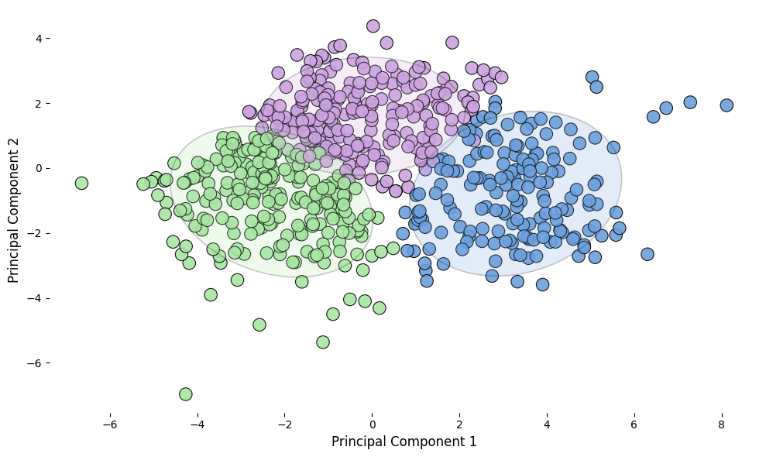
Insight 2- Three Distinct Shopper Segments Revealed
Cluster 1 - Convenience Snackers
Cluster 1 is characterised by significantly higher purchases of ready-made meals, soft drinks and sweets, combined with lower spending on fresh and cooking ingredients such as fish, fats/oils, red meat and eggs. This suggests a convenience-oriented consumption pattern where processed and less healthy ready-to-eat foods are preferred. (Average Age: ~37.8 years & Population Density: ~4,951 people per sq km)
Cluster 2 – Fresh & Premium Shoppers
Cluster 2 displays higher purchases of fresh foods such as fish, fruit and vegetables as well as wine and beer, alongside lower consumption of processed and sugary items like soft drinks, sweets and ready-made meals. This indicates a more health-conscious consumption pattern focused on fresh ingredients, combined with higher wine and beer consumption. (Average Age: ~37.0 years & Population Density: ~9,985 people per sq km)
Cluster 3 - Hydrated Home Cooks
Cluster 2 is characterised by higher purchases of water, fats/oils, sauces, eggs/meat, indicating a diet based on home-cooked meals. Higher consumption of spirits also distinguishes this cluster from the others. They also drink noticeably less wine and beer and consume fewer ready-made meals. (Average Age: ~34.4 years & Population Density: ~10,077 people per sq km)

Slide 7
Task 3 - Description of the Income Dataset
Dataset chosen: ONS Model-Based Income Estimates, MSOA (https://data.london.gov.uk/dataset/ons-model-based-income-estimates-msoa-e113d/, n.d.)
Provides estimates of mean household income for MSOAs in England and Wales. 2015/16 data was chosen for use.
Dataset provides four distinct measures of income (annual): total household income, net household income, net household income (equivalised) before housing costs, net household income (equivalised) after housing costs.
Total = sum of gross income and benefits over every member of the household.
Net = sum of net income (after taxes, deductions etc.) over every member of the household.
The data was then filtered by London borough to capture larger scale trends.
Appropriate for the task: data is taken from essentially the same time period (financial year vs calendar year) and over the same geographical boundaries (MSOA and by local authority e.g. borough). Also contains disposable income measures.
What does it contin
Notes:
Equivalised = adjusted for household size/composition.

Slide 8
Task 3 - Assumptions and Limitations
Limitation 1
Limitation 2
Mean over the MSOA hides variation
We assume the mean income over the MSOA is representative of the typical shopper.
Have no idea how income is distributed.
Shrinkage to the mean
The estimation procedure used shrinks income estimates towards the mean --> over and under estimation.
Confidence intervals should be used to see variability.

Slide 9
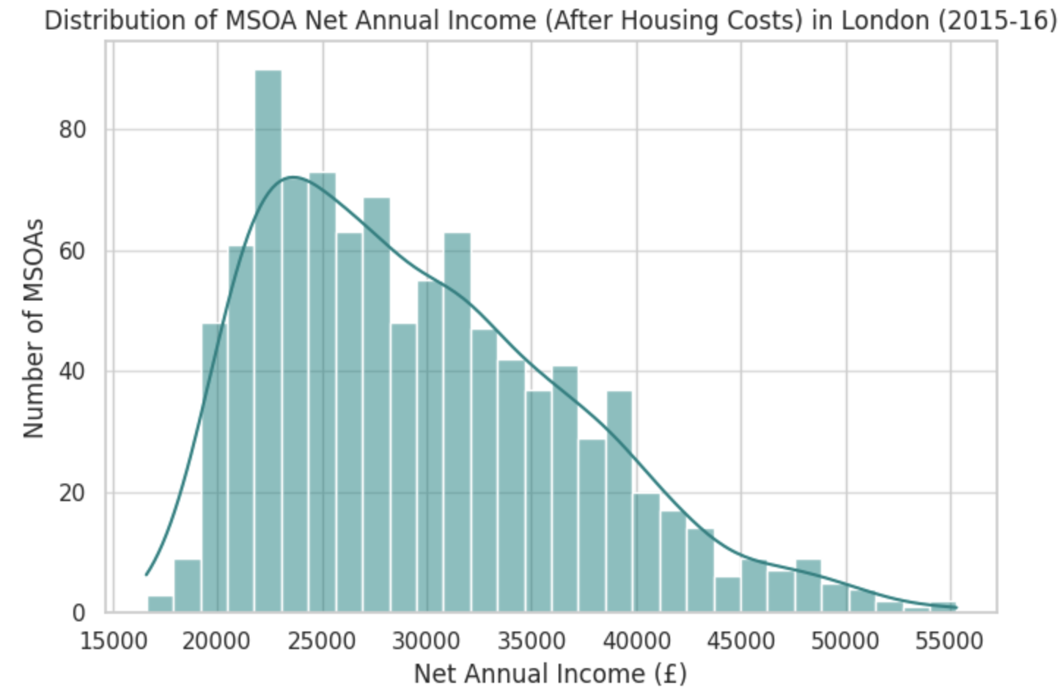
Task 3 – Preliminary Analysis of Income Dataset
Roughly normally distributed with most MSOAs having average net annual income after housing costs around £20,000 to £40,000.
Positively skewed: Few high income MSOAs skew the distribution to the right. Although there are very few: very high disposable income --> opportunity to target for premium products.
Insight 1

Slide 10
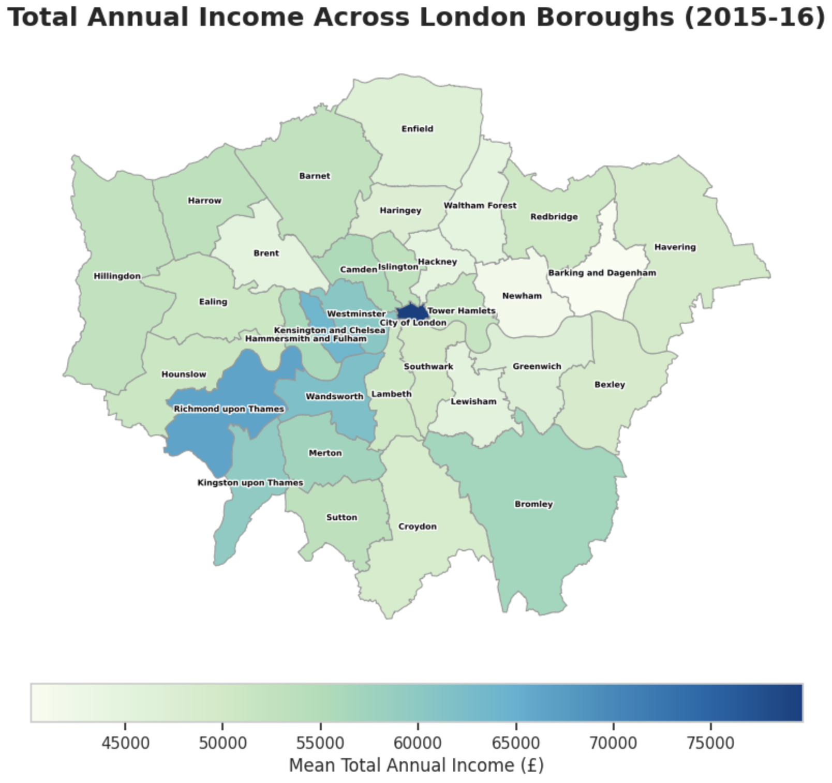
Task 3 – Preliminary Analysis of Income Dataset
Highest average income boroughs are located in Central, Central West and South West London.
City of London has the highest mean annual income, along with boroughs like Kensington and Chelsea, Westminster and Richmond upon Thames --> sell more premium products here?
East London (like Barking and Dagenham etc.) and North London boroughs (like Enfield) have lower mean annual incomes.
Insight 2
Plotted using london_boroughs.geojson
(https://github.com/radoi90/housequest-data, n.d.)

Slide 11
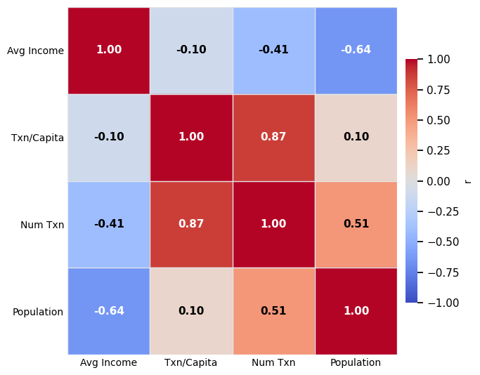
Task 3 — Combining Datasets
Wealthier boroughs spend less per visit but shop more often
Average income has a near-zero relationship with transactions per capita (r = −0.10), but a strong negative correlation with total transaction volume (r = −0.41), suggesting wealthier areas have smaller and more frequent basket behaviour.
Higher-income boroughs are less populated
The strong negative correlation between average income and population (r = −0.64) reflects London's geography. Wealthier boroughs like the City of London (£72k) are low-density, while high-population boroughs like Newham (£28k) are the highest-volume locations.
Volume is driven by population, not income
The strong correlation between population and number of transactions (r = 0.51) confirms that store throughput is associated with density.
Transactions per capita and total transactions move together (r = 0.87)
Boroughs with high per-capita engagement also generate the most absolute volume, identifying a core group of high-loyalty and high-revenue boroughs worth prioritising for investment.

Slide 12
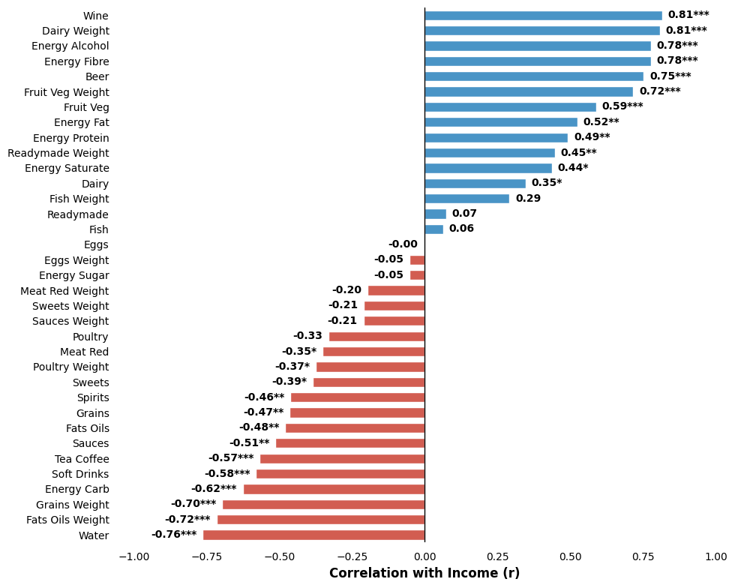
Task 3 — Income vs Food Purchasing: Correlation Analysis
Income vs. Shopping Habits
There is a very strong relationship between higher income and the consumption of Wine (r=0.81), Energy from Fibre (0.78), and Fruit & Veg (0.72). Higher-income households are prioritizing health-associated nutrients (fibre) and lifestyle categories (alcohol).
As income decreases, we see a sharp increase in the purchase of Water (-0.76), Fats & Oils (-0.72), and Grains (-0.70). This suggests that lower-income households rely more heavily on pantry staples and basic hydration.
While Red Meat (-0.35) and Soft Drinks (-0.58) correlate with lower income, Dairy Weight (0.81) and Energy from Fat (0.52) lean toward higher income. This indicates a clear divergence in how different income tiers source their protein and energy.
Most categories shown with three stars ($***$) indicate high statistical confidence. The strongest correlations (above 0.70 or below -0.70) represent the most reliable predictors of customer wealth segments.

Slide 13
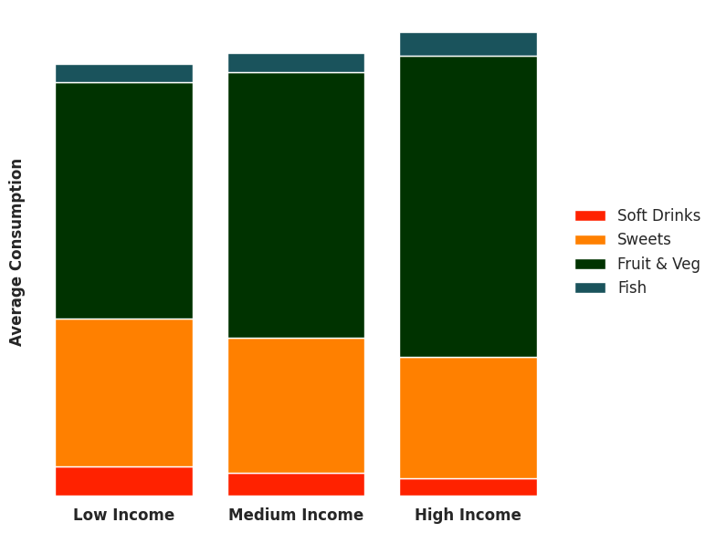
Does Income Affect Diet Composition? (MSOA Evidence)
Main Findings:
Higher income → more fresh foods Fruit & veg share ↑ ~10% per log income, dairy ↑ ~0.8% (p < 0.001)
Lower income → more fats & sweets
Fats & oils ↓ ~0.5%, sweets ↓ ~4.5% per log income (p < 0.001)
Ready meals displace fresh foods
Fruit & veg drop sharply where ready meals ↑ (~-1.33, p < 0.001). Healthy consumers who eat lots of fruit and veg avoid ready meals and vice-versa.
Other factors
Dense areas → more fresh foods, fewer sweets
Older populations → slightly more sweets & ready meals
De Agostini (2014) — The Effect of Food Prices and Household Income on the British Diet · ISER Working Paper 2014-10
[1] De Agostini, P. (2014) ISER Working Paper 2014-10, University of Essex

Slide 14
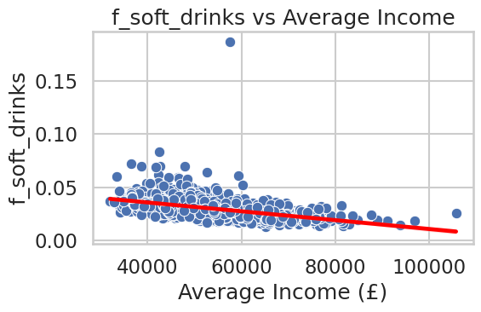
Soft Drink Consumption by Income Level
Bottom 20% income areas consume more soft drinks than top 20% areas.
Difference: +0.013 servings per capita (0.036 vs 0.023).
Data shows mean soft drink intake by income quintile; higher values indicate higher consumption.
A multilevel study of area socio-economic
status and food purchasing behavior · Cambridge University Press 2009-02
[2] A multilevel study of area socio-economic status and food purchasing behavior ·Cambridge University Press (2009)

Slide 15
References
Aiello, L.M., Quercia, D., Schifanella, R. and Del Prete, L., 2020. Tesco Grocery 1.0, a large-scale Dataset of Grocery Purchases in London. Scientific Data, 7(1).
De Agostini, P., 2014. ISER Working Paper Series the Effect of Food Prices and Household Income on the British Diet [Online]. Available from: https://www.iser.essex.ac.uk/wp-content/uploads/files/working-papers/iser/2014-10.pdf.
French, S.A., Wall, M. and Mitchell, N.R., 2010. Household income differences in food sources and food items purchased [Online]. International Journal of Behavioral Nutrition and Physical Activity, 7(1), p.77. Available from: https://doi.org/10.1186/1479-5868-7-77.
Gengler, D., 2026. A Deeper Look at the Tesco Dataset Using Food Categories [Online]. P-ADA-WAN Tesco Data Story. Available from: https://p-ada-wan.github.io/ [Accessed 25 March 2026].
https://data.london.gov.uk/dataset/ons-model-based-income-estimates-msoa-e113d/ , n.d.
https://github.com/radoi90/housequest-data, n.d.
Turrell, G., Bentley, R., Thomas, L.R., Jolley, D., Subramanian, S. and Kavanagh, A.M., 2009. A multilevel study of area socio-economic status and food purchasing behaviour [Online]. Public Health Nutrition, 12(11), pp.2074–2083. Available from: https://doi.org/10.1017/s1368980009004911.
What does it contin

